Slide 1
Team Name: ELITE GROUP
Project Name: AGRIBOT: EFFECTIVE PLANT MONITORING ROBOT
Theme: Responsible Consumption and Production Date: 01-08-2022
Place: ERODE
Initial design concept

Slide 2
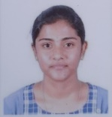
Team Members
Name: SIVAPRIYA S Title: Team leader Role in the Project: Designer/Ideation

Slide 3
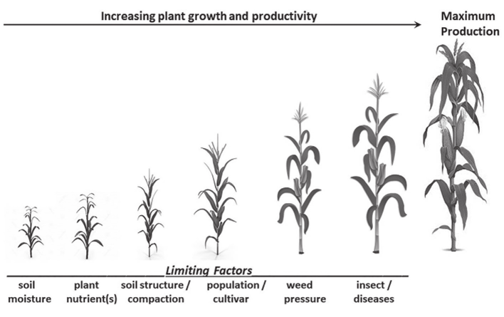
Problem Identified
PROBLEM DESCRIPTION During crop cultivation, one of the major factor affecting the production is plant diseases. It reduces the production yield, affects the cultivators financially and sometimes leads to wastage and scarcity of food.
Background:
Agriculture which is the backbone of our country’s economy faces many productivity issues. One of the problem is the plant diseases. It is untraceable sometimes which leads to wastage of the plant. This untraceable issue affects the time, money and manpower. Sometimes Infectious diseases affects the entire cultivation. The rural farmers gets affected the most due to lack of awareness. There are few solutions available to the problem such as spraying of pesticides and insecticides and usage of hybrid, Genetically modified seeds.

Slide 4
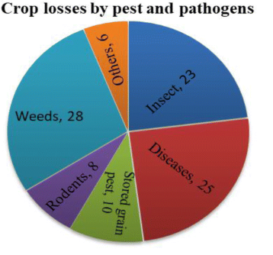
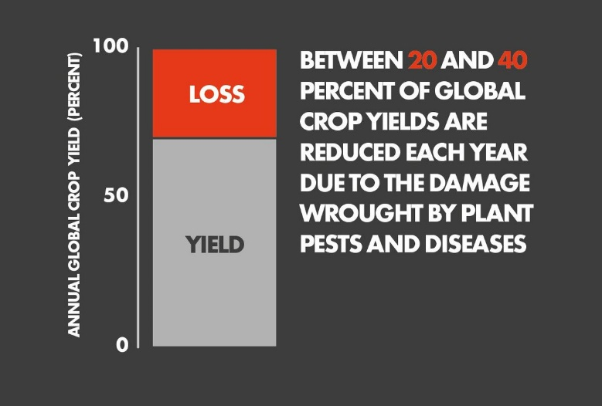
Significance
WHY IS IT AN URGENT PROBLEM?
Agriculture is the backbone of India and it is the important and major source of livelihood in India. Agriculture is called the backbone of Indian economy because 70% of Indian population are engaged in agriculture and raw material for the Industrial sectors like food processing company, textile industry comes from the agricultural sector. Agriculture contributes almost 70 percentage of the livelihood of rural people and 40 percentage of urban peoples. So, once the yield gets affected, the farmers get financial loss of about 30 to 40 percentage. Once they use existing solutions such as pesticides, the quality of the yield gets affected which leads to wastage of food products. The disease in plants affects the yield by a quarter percentage. Once the problem gets identified and solved at the initial stage, the issue can be reduced. Thus, the farmers can yield more and the price of the food products gets reduced which leads to availability of more quality and quantity of food in the society.

Slide 5
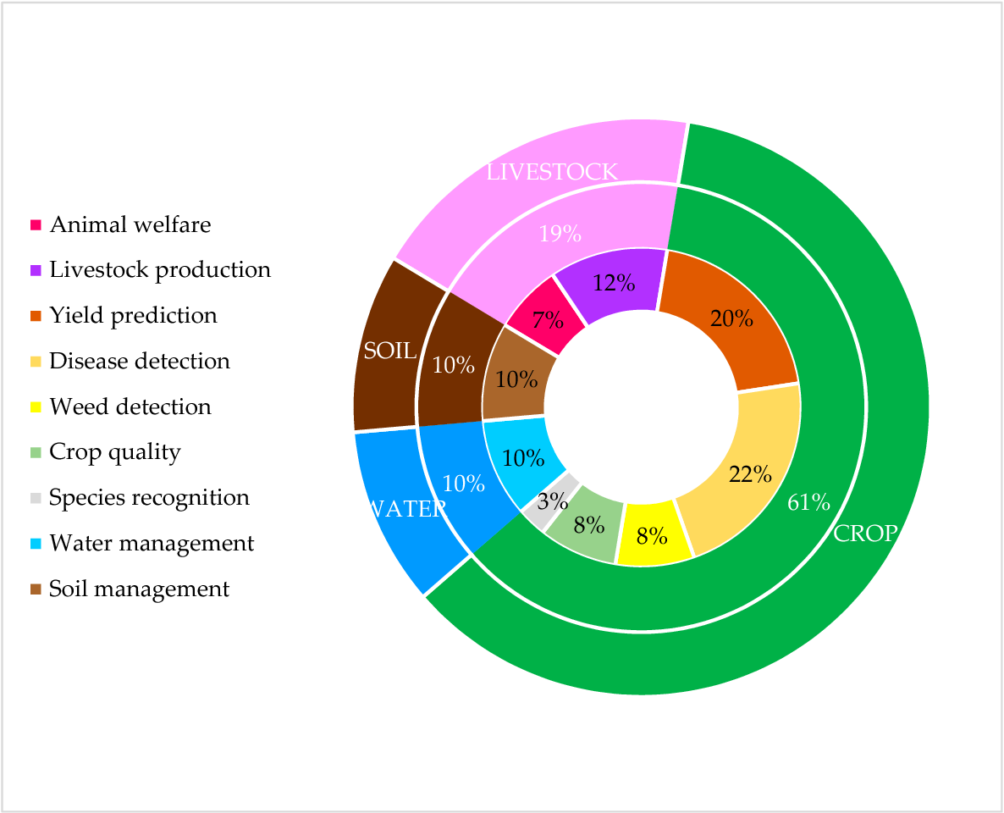
Research Findings
What are important findings in the research?
It is Concluded that the productivity is affected by a quarter due to diseases in plants which affects the livelihood of small marginal farmers economically. Thus it is proposed to use Machine Learning in the problem. The machine learning finds a significance application modern cultivation. The disease can be detected in the plants and the infection can be restricted about 22 percentage. The machine learning can be implemented with low cost also it is effective. The cost efficient implementation is feasible to every small scale farmers, as Indian small scale farmers prefer systems and tools with low cost as they can afford it easily. From urban or large scale farmers point of view, a large amount of money and yield can be earned by using this technology.

Slide 6
User Persona
PROFILE & DEMOGRAPHICS
Job Title: Local farmer Gender: Female Family and Social Setting: Married Income: 350000 Annually Education: 10th grade (Quits after 10th to take care of farming)
ATTITUDES & MOTIVATION
Attitudes: Key decision maker on what to grow Beliefs: Relies on traditional farming methods Motivations: To maximize the efficiency of his livelihood
PAIN POINTS
Fears: Less yield, losing crops Frustrations: some of the plants gets diseased at the time of cultivation Challenges: Has to contact kisan call centre for basic needs.
FEELINGS
Worries: Climate changes, water scarcity Influences: Holding a tractor and a borewell.
TASKS
Activities: Farming and cattle Resources available: 5 Hectares of farming land

Slide 7
Product Specifications
Components required
Chassis – The base of the design on which the parts and components are mounted. Also to withstand the forces and loads.
Arduino – The microcontroller which is used to connect the drives and motors to run the robot.
Raspberry Pi – The microprocessor which is used to predict the disease using camera and sends the feedback to the server.
Ibt – 2 Hbridge – The motor driver module used to connect between Arduino and motors.
Raspberry Pi camera module – The device used to sense the plants.
Motors – The prime mover of the robot used for motions which is a DC motor.
Battery – The power source of the robot design.
Ultrasonic sensor – The sensor used for detection of obstacles so that effective autonomous motion is achieved.
Technical requirements
Solidworks
Arduino IDE
TensorFlow
Human factors requirements – Not much required.
Constraints – Skilled user is required.

Slide 8
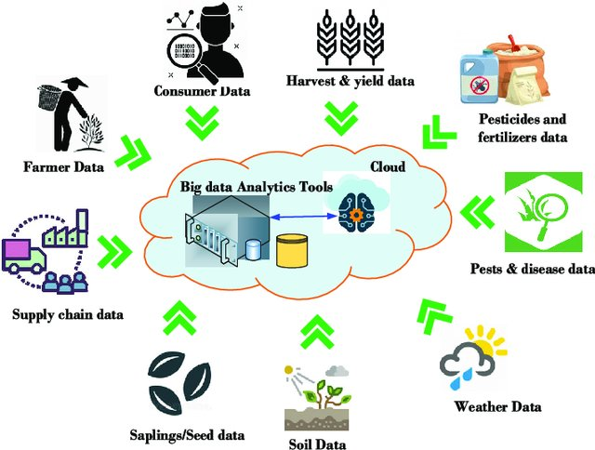
Concept Direction
The various modern technologies and tools were studied for the effective solution of the problem. The Artificial Intelligence, Machine Learning and Electronic Controllers were chosen for the solution product design. The factors that influenced the selection of the tools were efficiency, modern culture, cost effectiveness, availability, reliability and feasibility. The Major and important in this design is the usage of cloud data to the robot. The conventional machines like pesticide sprayer reduces the problem effectively with less cost but it also reduces the quality of the yield. To overcome the demerit, the solution we have proposed is the only effective method.

Slide 9
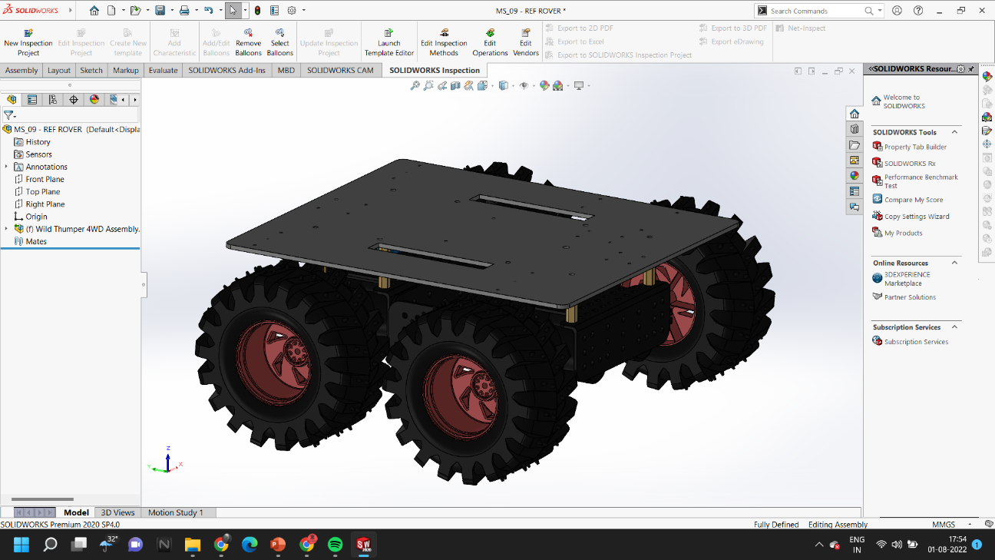
Explorations
Finally, the design is initially tested for its strength in solidworks. The robot must have enough rigidity, less in weight. So, an aluminium chassis with mobile ATV like design is to be designed in which the supporting components can be mounted.

